Slide 1
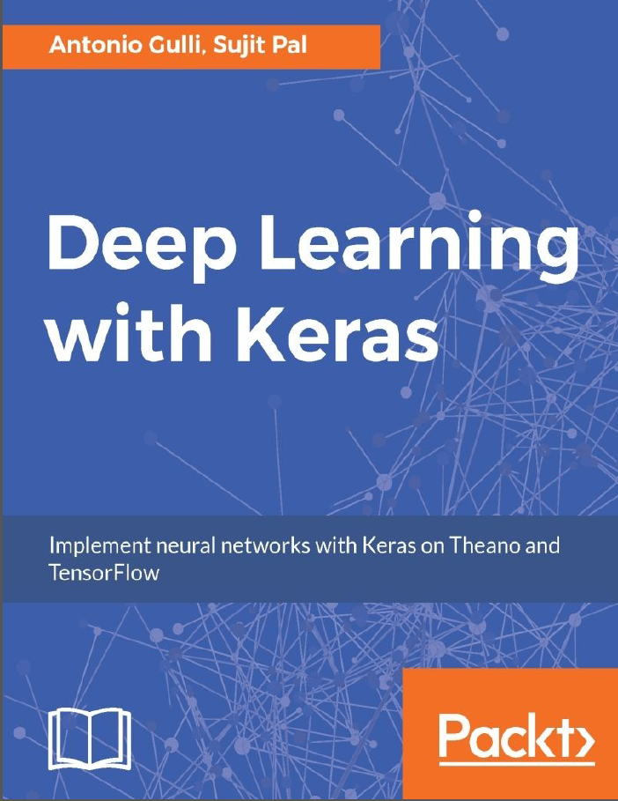
Getting Start Deep Learning with Keras
Ingyu Lee
Troy University
https://github.com/GoTrojan/DeepLearning

Slide 2
Contents
What is this talk about?
Introduce Deep Learning with KERAS.
Who needs this talk?
Who are interested in Deep Learning and about to start develop one.
What will be covered?
How to start with deep learning with KERAS.
What will not be covered?
Detail applications on deep learning.
Theory on deep learning.
If you are already familiar with KERAS or other deep learning platform, then this is not good for you.

Slide 3
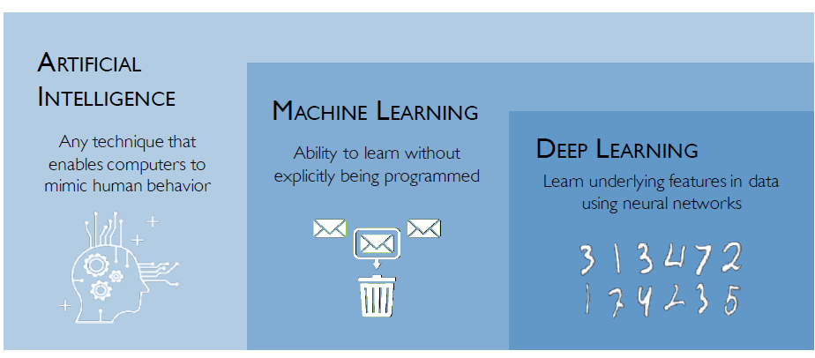
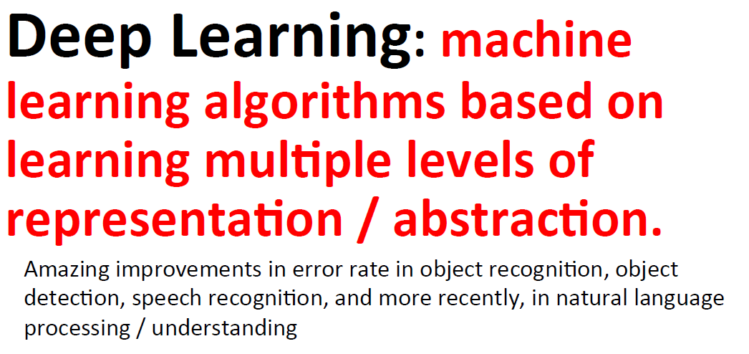
What is Deep Learning?

Slide 4
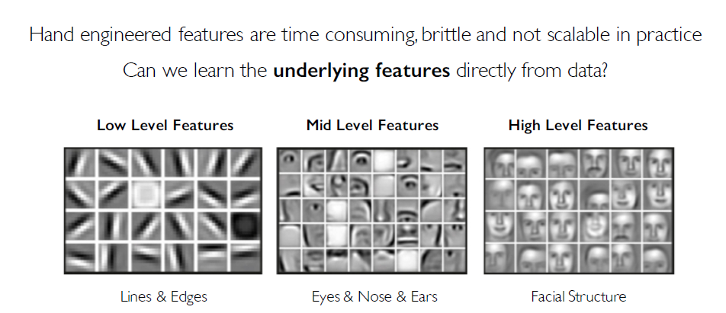
Why Deep Learning?

Slide 5
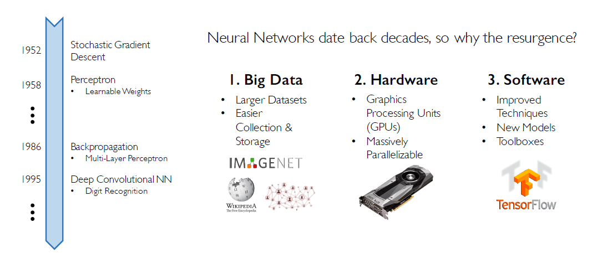
Why Now?

Slide 6
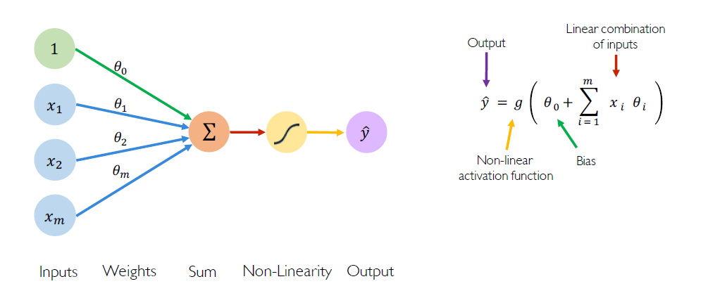
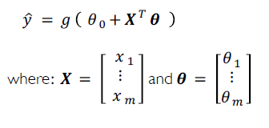
Background: Perceptron

Slide 7
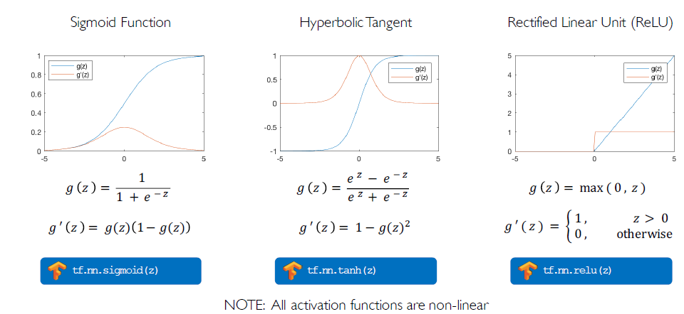
Background: Common Activation Functions

Slide 8
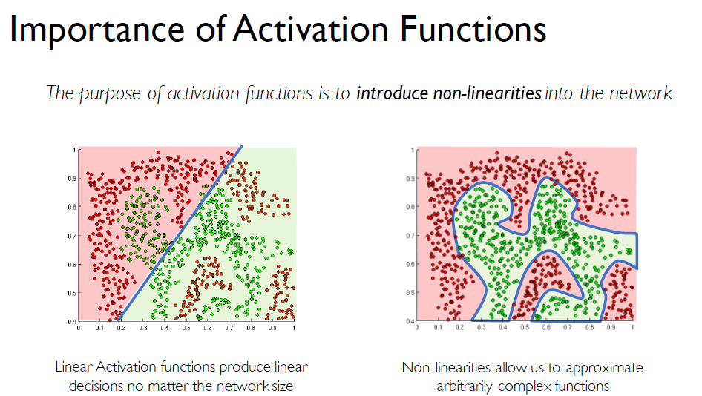
Background: Activation Functions

Slide 9
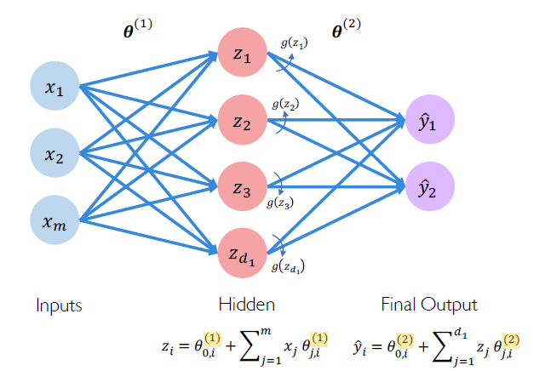
Single Layer Neural Network

Slide 10
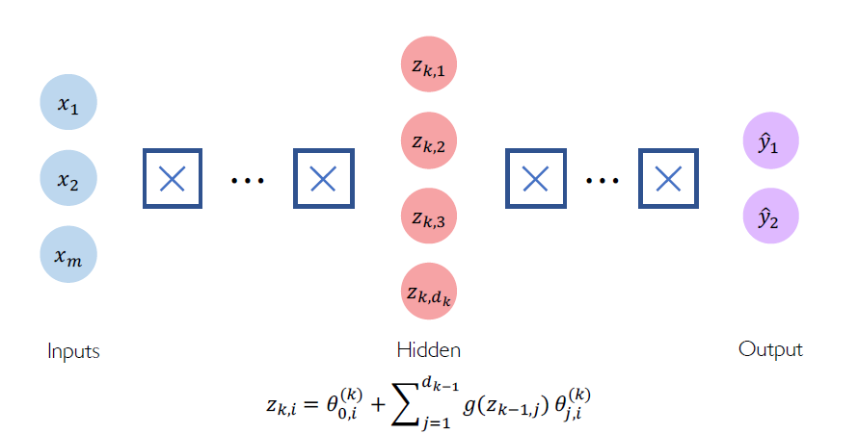
Deep Neural Network

Slide 11
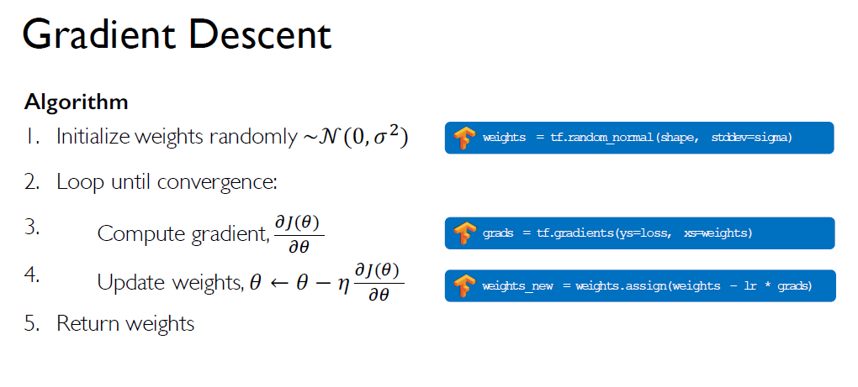
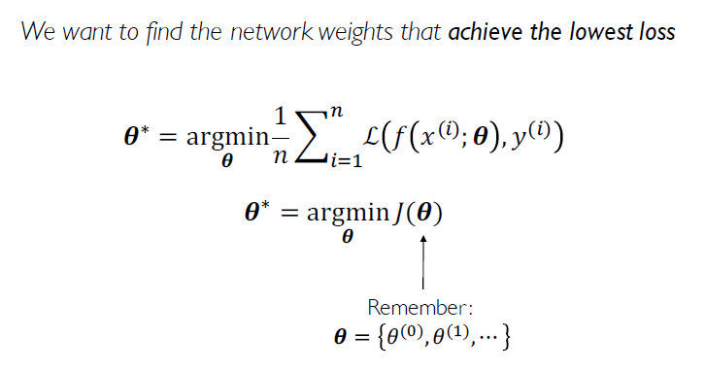
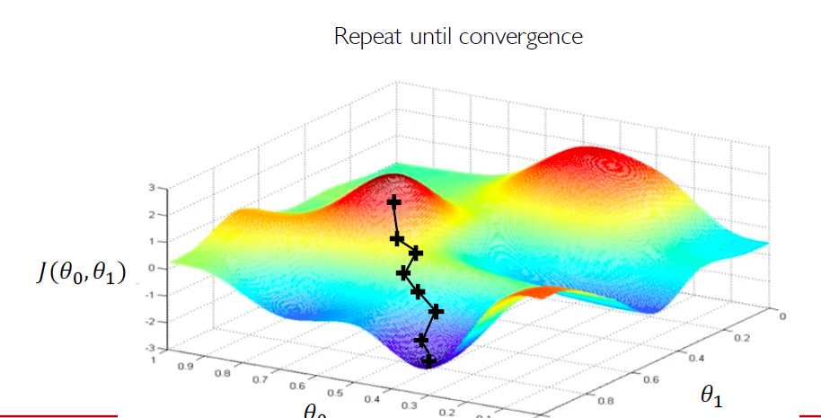
Training Neural Network

Slide 12
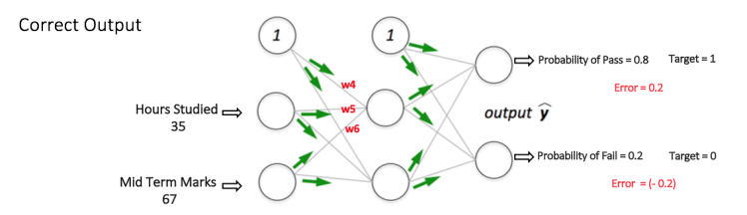
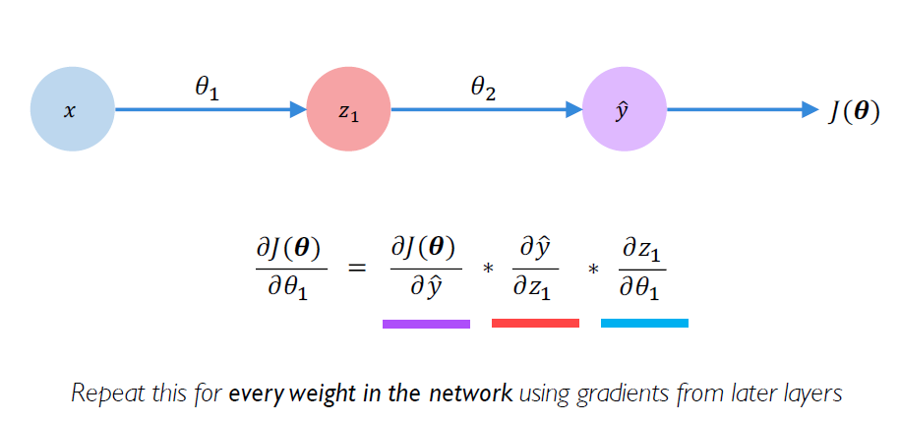
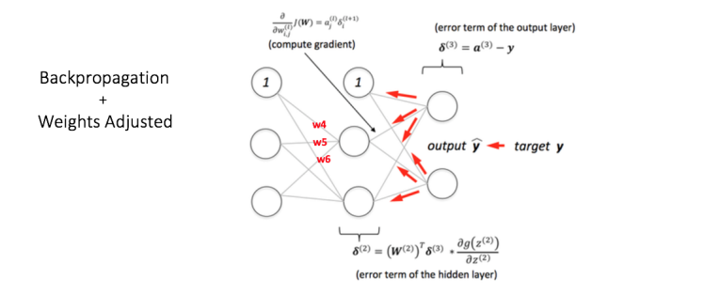
Computing Gradients: Backpropagation

Slide 13
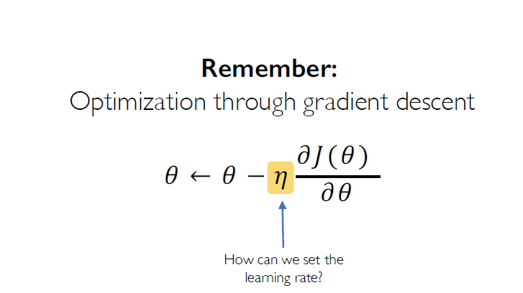
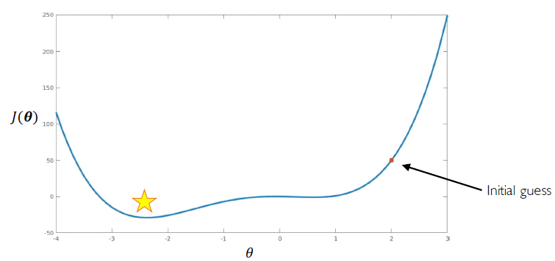
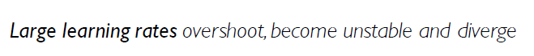
Loss Functions Can be Difficult to Optimize

Slide 14
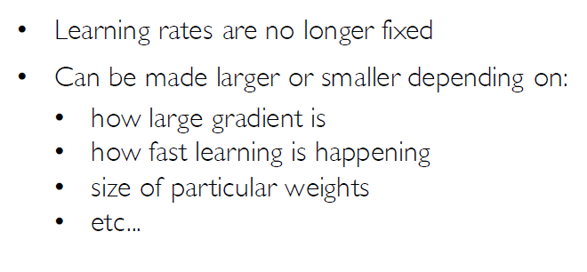
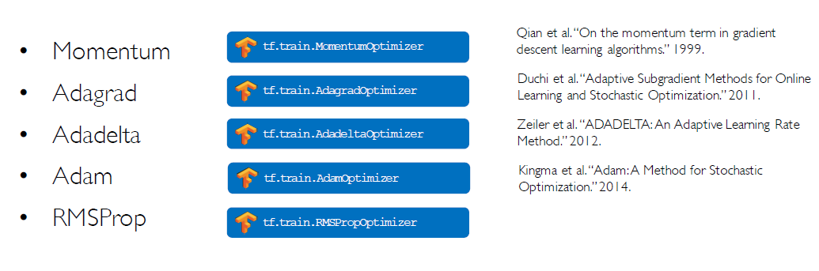
Adaptive Learning Rates

Slide 15
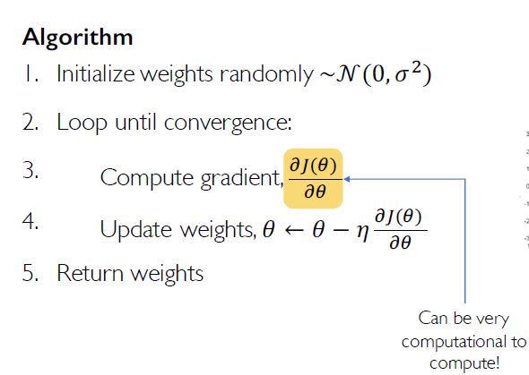
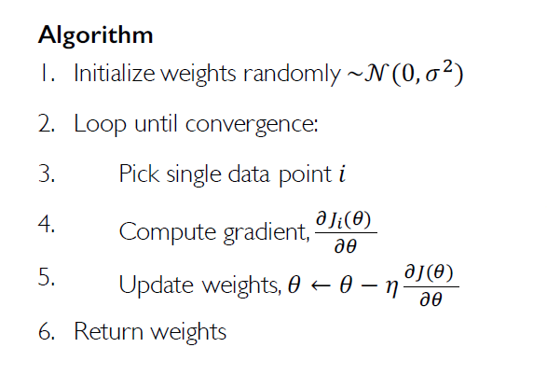
Stochastic Gradient Descent

Slide 16
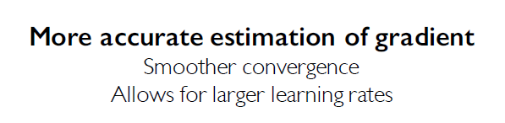
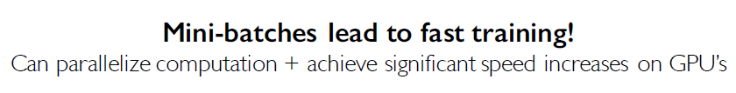
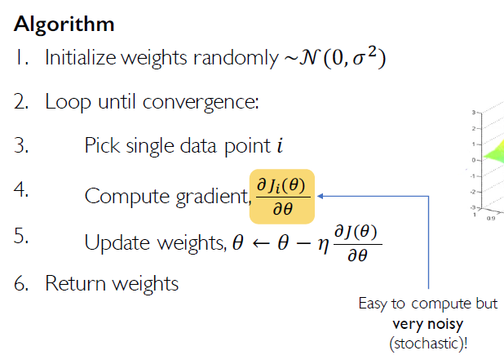
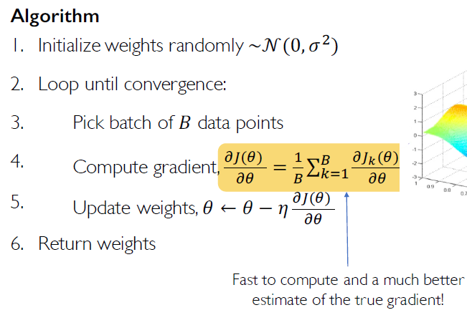
Mini-Batches

Slide 17
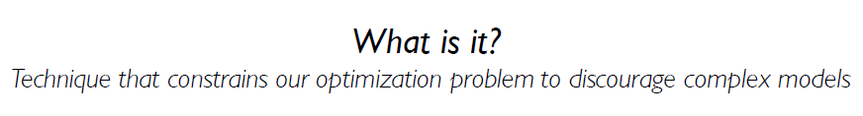
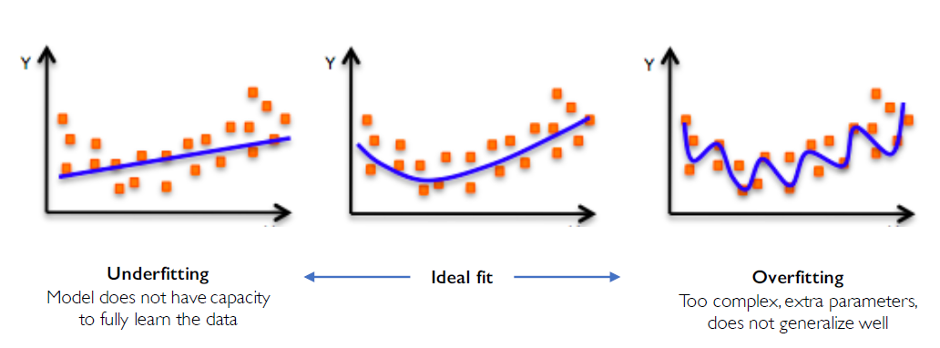
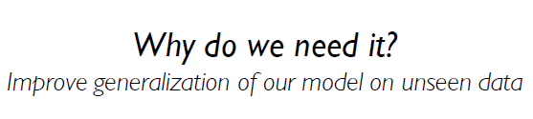
Overfitting
Regularization

Slide 18
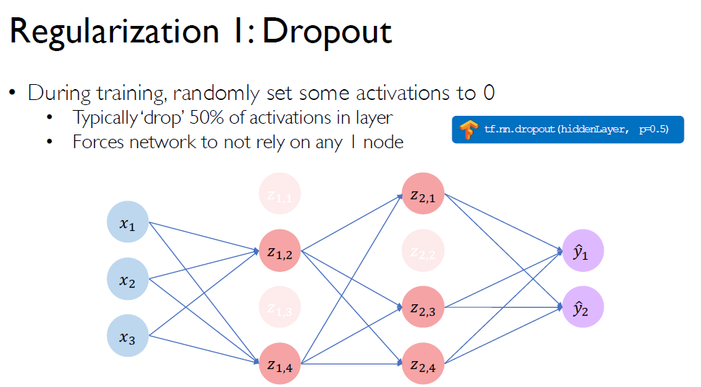
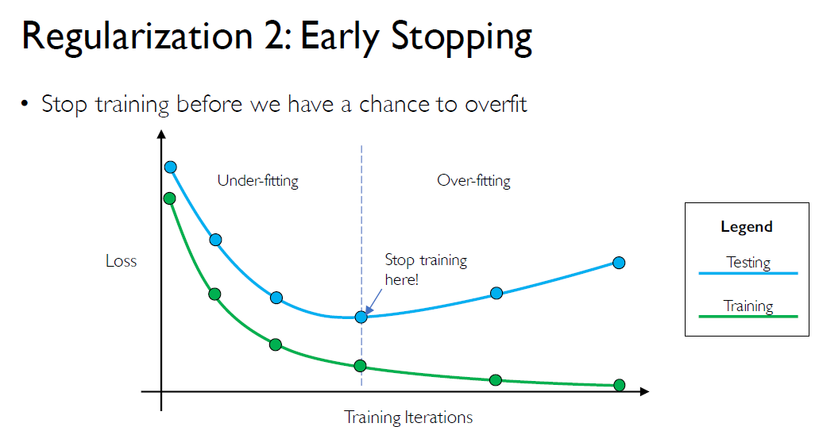
Regularization

Slide 19
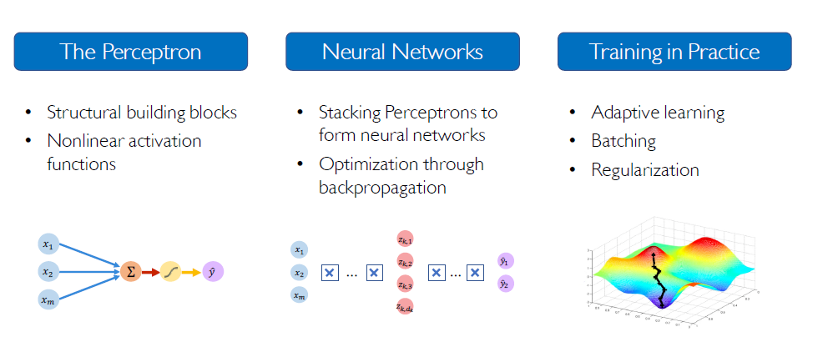
Foundation Summary

Slide 20
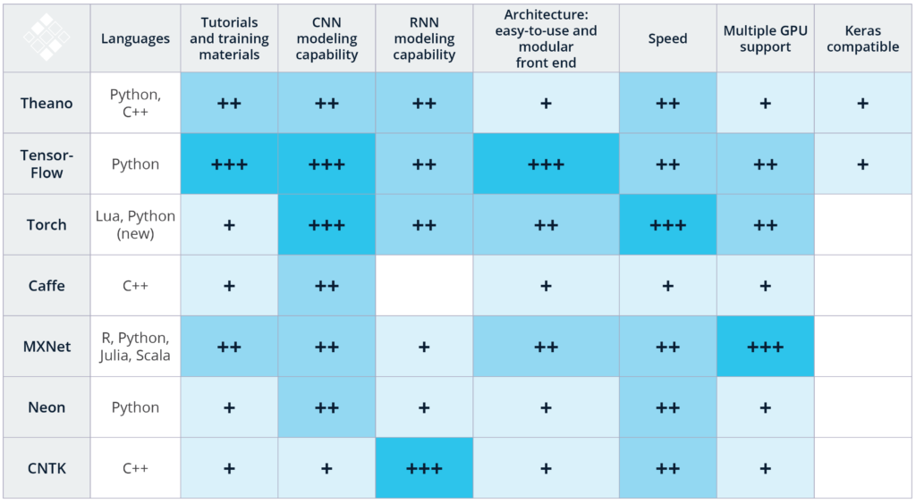
Deep Learning Frameworks

Slide 21
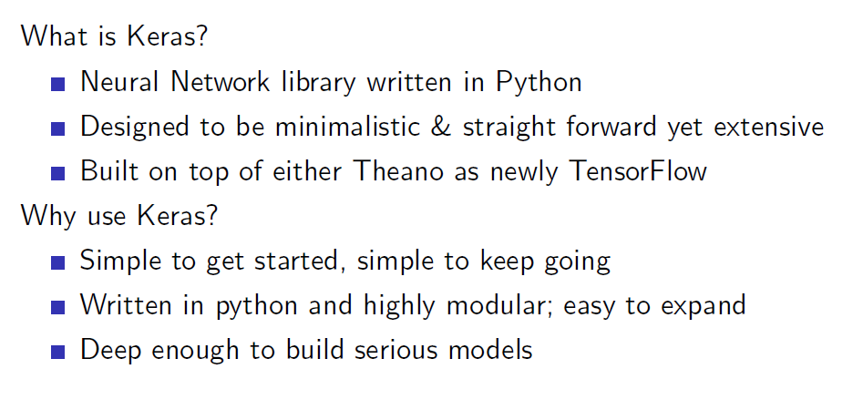
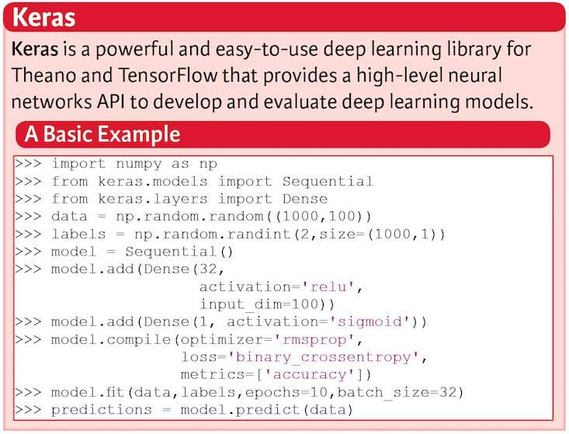
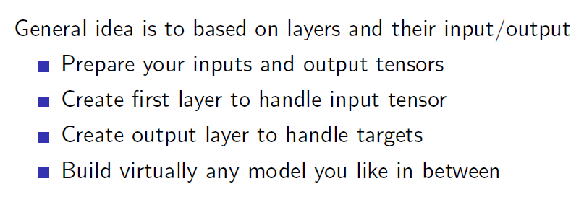
Keras

Slide 22
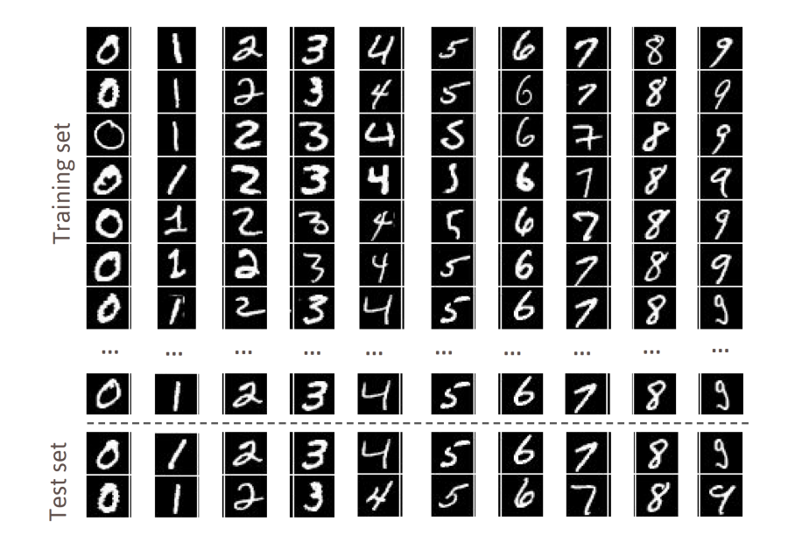
First Applications
28 x 28 pixels
We will build a neural network that can recognize handwritten numbers.
We use MNIST (a database of handwritten digits made up of a training set of 60,000 examples and a test set of 10,000 examples.
The examples are annotated by humans with the correct answer. Since a database with correct answers is available, we can perform a supervised learning.

Slide 23
Step 1: Set up your environment
Python 2.7+
SciPy and NumPy
Matplotlib
Theano
Tensorflow
sudo apt-get update
sudo apt-get install python-pip python-dev build-essential
sudo pip install --upgrade pip
sudo pip install ipython
sudo apt-get install libopenblas-dev liblapack-dev gfortran python-numpy python-scipy
sudo pip install matplotlib scikit-learn scikit-image protobuf jupyter
sudo pip install tensorflow
sudo pip install Theano
sudo pip install keras

Slide 24
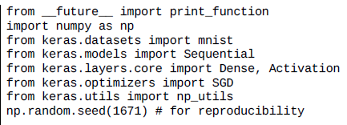
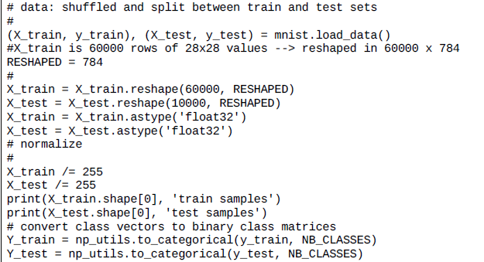
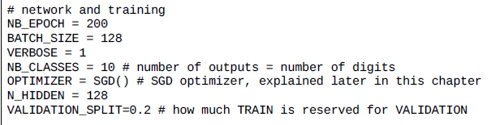
Step 2: Import the libraries and dataset

Slide 25
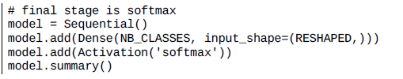
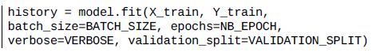
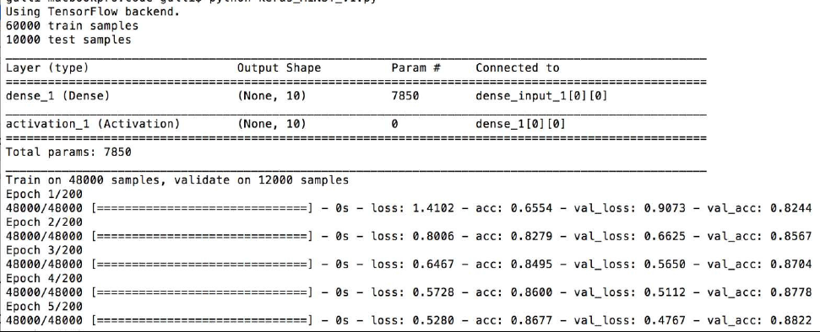
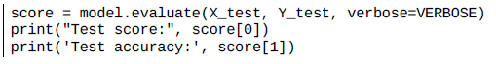
Step 3: Define networks and run the model

Slide 26
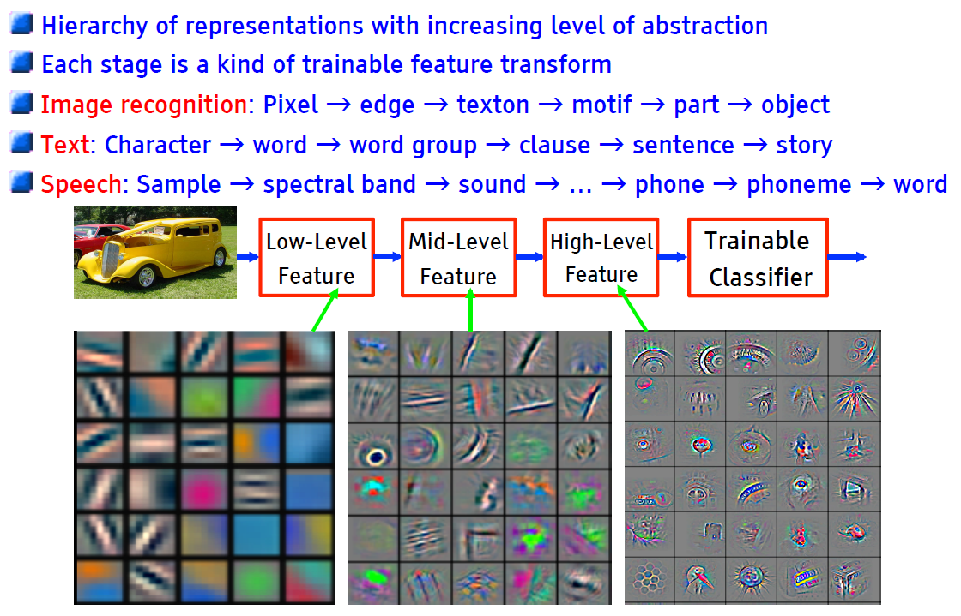
Why Multiple Layers? The World is Compositional

Slide 27
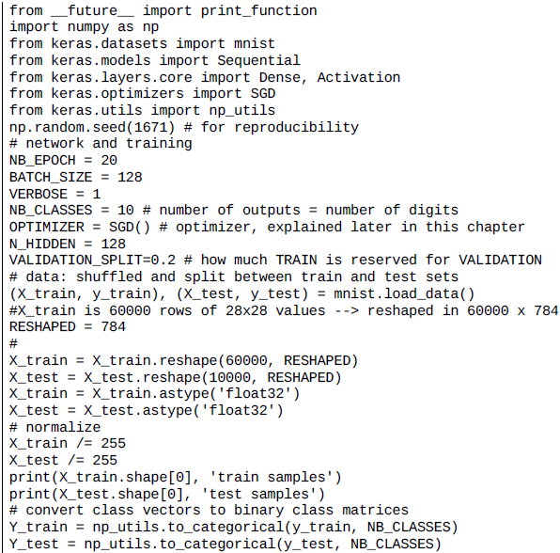
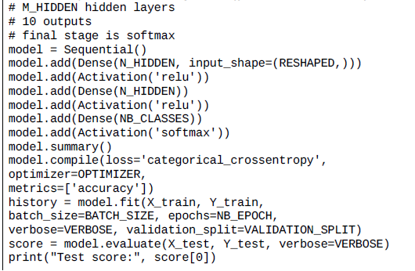
Improve the model with hidden layers

Slide 28
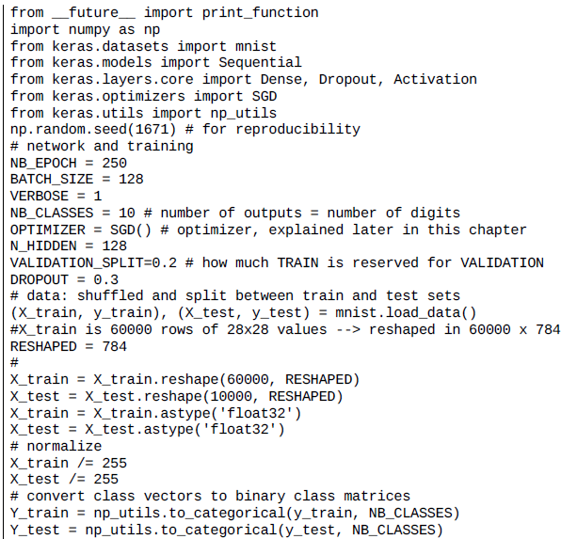

Further improvement with dropout

Slide 29



Other Improvements
Use different optimizers in Keras
Stochastic gradient descent (SGD)
RMSprop and Adam
Increasing the number of epochs.
Controlling the optimizer learning rate.
Increasing the number of internal hidden neurons.
Increasing the size of batch computation.
Adopting regularization for avoiding overfitting.

Slide 30


Fully Connected Neural Network

Slide 31

Feature Extraction with Convolution

Slide 32

Introducing Non-Linearity

Slide 33

CNNs for Classification

Slide 34

CNNs: Spatial Arrangement of Output Volume

Slide 35

Pooling

Slide 36

CNNs for Classification: Feature Learning

Slide 37

CNNs for Classification: Class Probabilities

Slide 38

CNNs: Training with Backpropagation

Slide 39



Example of CNN: LeNet

Slide 40


Example of CNN: LeNet

Slide 41

Recognizing CIFAR-10 images with deep learning
The CIFAR-10 dataset contains 60,000 color images of 32 x 32 pixels in 3 channels divided into 10 classes.
Each class contains 6,000 images. The training set contains 50,000 images and test sets provides 10,000 images.
The goal is to recognize previously unseen images and assign them to one of the 10 classes.

Slide 42





Recognizing CIFAR-10 images with deep learning

Slide 43



Recognizing CIFAR-10 images with deep learning

Slide 44


Improving the CIFAR-10 performance with deeper network

Slide 45



Improving the CIFAR-10 performance with data augmentation

Slide 46


Very deep convolutional networks for large-scale image recognition

Slide 47

Very Deep ConvNet Architectures

Slide 48

Deep Learning for Computer Vision: Review

Slide 49


To model sequences, we need

Slide 50

Gated cells

Slide 51


LSTMs

Slide 52

Why do LSTMs help?

Slide 53

Back To Keras: Layers and Layers

Slide 54



Layers and Layers

Slide 55

Activations

Slide 56

Objectives and Optimizers

Slide 57

Parallel Capabilities

Slide 58

Architecture/Weight Saving and Loading

Slide 59

Callbacks

Slide 60

In Summary
Thanks for your attentions !

Slide 61





Coursera Courses

Slide 62





Coursera Courses

Slide 63








edx Courses

